Slide 1
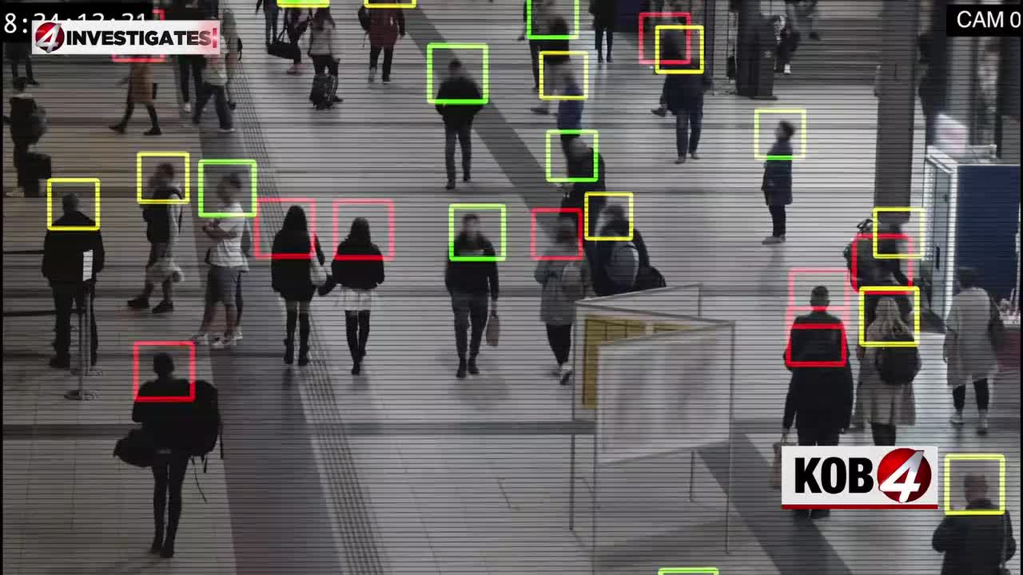
Facial Recognition & Biometrics
Using AI for Identification, Safety, and Investigation

Slide 2
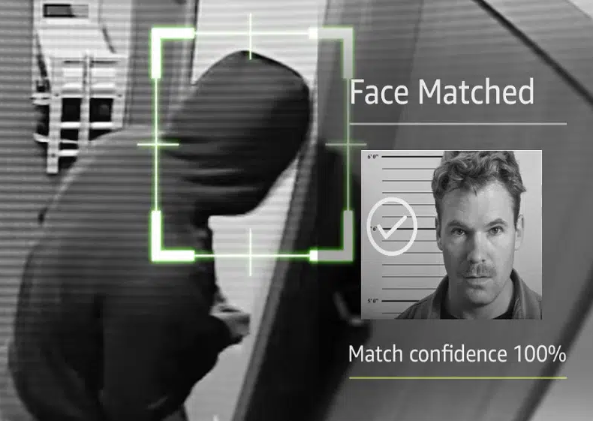
What is Facial Recognition?
Facial recognition is an AI/computer vision technique that identifies or verifies a person using their biometric facial features.
How it works:
Detects a face in an image or video
Extracts measurable biometric features (distances, shapes, embeddings)
Compares those features to a stored database
Produces an identity or similarity score

Slide 3
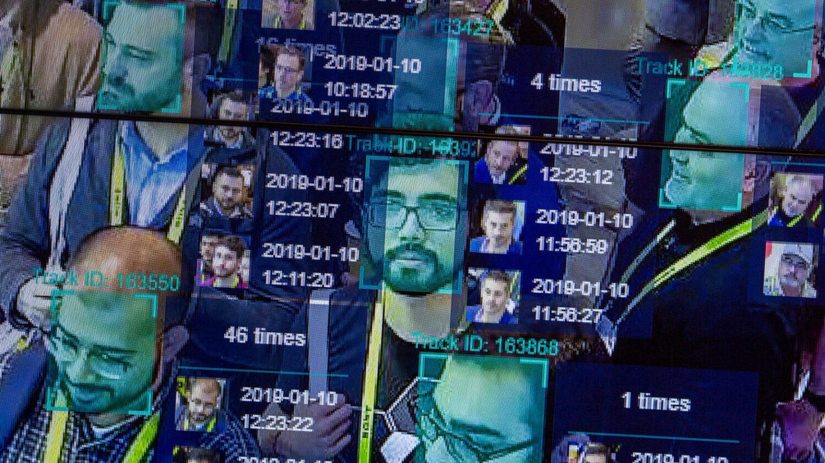
Different Approaches to Facial Recognition
Face Detection:
Classical models like Haar Cascades or HOG detect the face region.
Feature Extraction:
Deep CNNs convert a face into a numerical vector (“embedding”).
Classification:
k-Nearest Neighbors (kNN)
Support Vector Machines (SVM)
Softmax Neural Networks
Verification:
Compares two faces to determine if they are the same person.
Biometric Matching:
Analyzes facial distances, eye spacing, jaw shape, and learned deep-features.

Slide 4
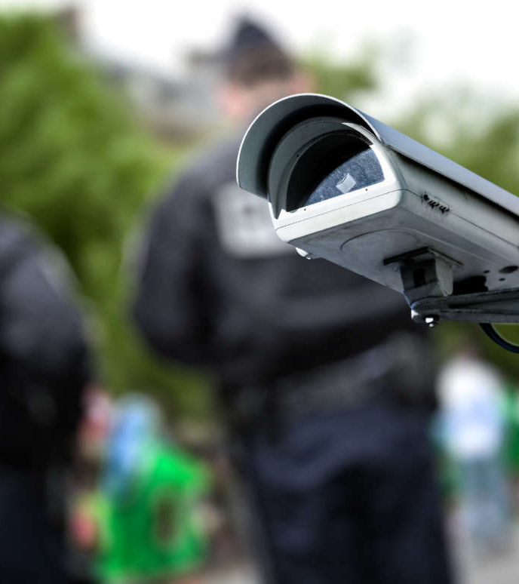
Police Use Cases of Facial Recognition
Facial Recognition helps law enforcement with:
Locating suspects
Identifying missing persons
Human trafficking investigations
Finding kidnapping victims
Real-time watchlist alerts
Scene analysis from CCTV / body cam footage
Post-incident forensic search
AI biometrics allow officers to detect, track, and confirm subjects with enhanced reliability.

Slide 5
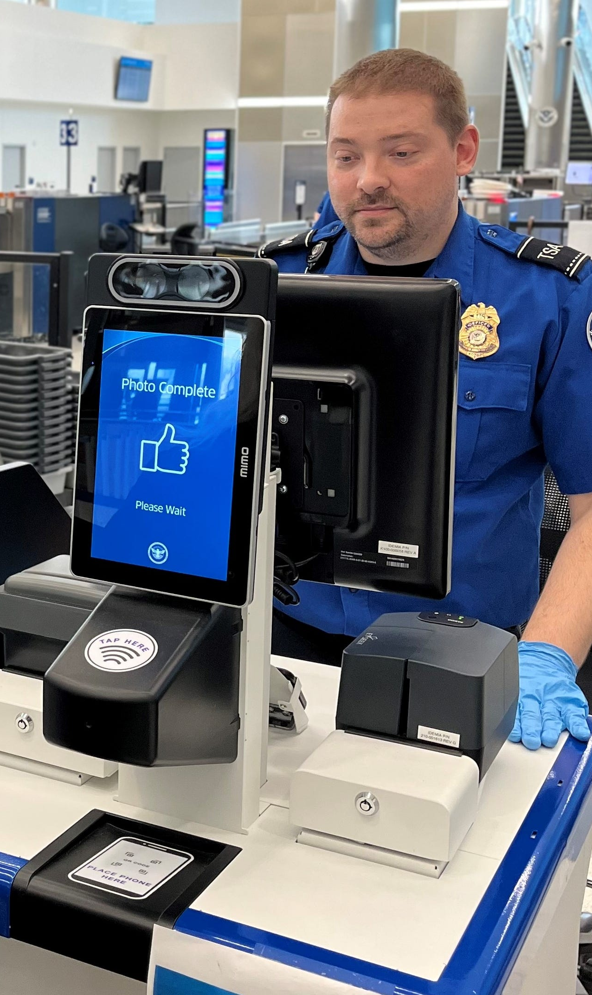
Security Applications of AI Facial Detection
How TSA & Airports Use AI Face Detection
TSA Checkpoints
  AI verifies traveler identity against government-issued IDs
  Facial biometrics match the real-time face to ID photos
  Reduces manual inspection errors
  Speeds up security lines
  Used in TSA Biometrics Technology Pilot and CAT-2 systems
Airports & International Travel
Used at automated passport kiosks
Confirms identities for immigration & customs
Detects forged or altered travel documents
Monitors restricted areas for unauthorized access
Helps locate flagged individuals on watchlists

Slide 6
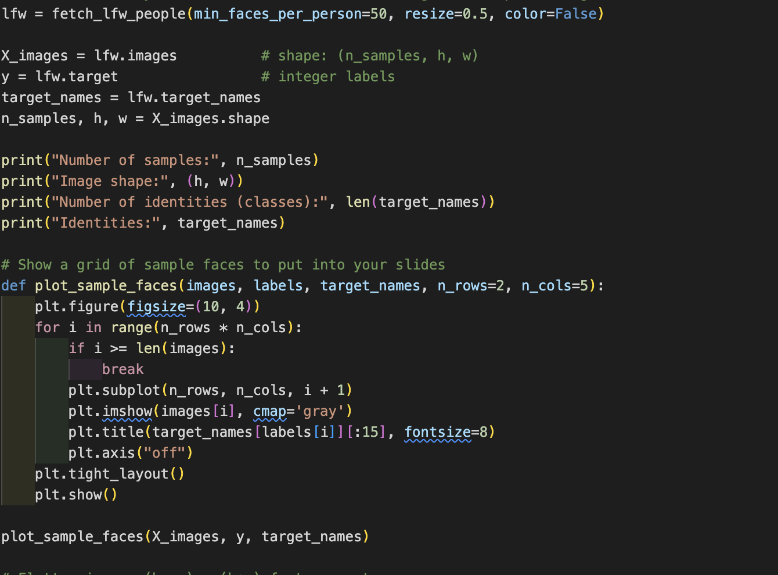
Dataset
Our project uses public facial datasets that simulate real-world security environments:
LFW (Labeled Faces in the Wild)
Uncontrolled natural images
Multiple identities, varying lighting & backgrounds
SCFace-Style Surveillance Data
CCTV-like images
Lower resolution, varying distances
VGGFace2-Style ID Photos
High-quality passport-like facial biometrics
Used to simulate TSA/airport identity checks

Slide 7
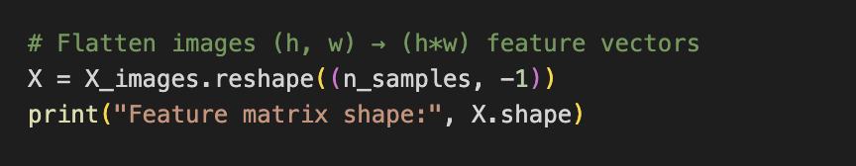
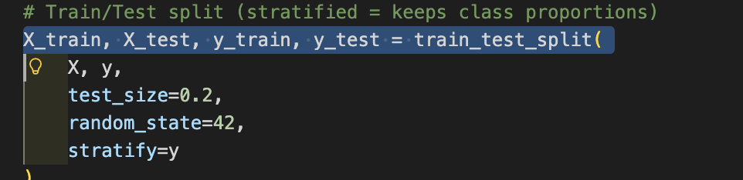
Data Pre-Processing
Steps Taken:
Loaded dataset samples
Converted each image to numerical arrays
Cropped + normalized facial regions
Flattened images into vectors
Applied PCA (150 components) for dimensionality reduction
Encoded identity labels
Split into training and testing sets (80/20)
Set input shape:
(h, w) for grayscale, flattened to (h*w,) after processing.

Slide 8
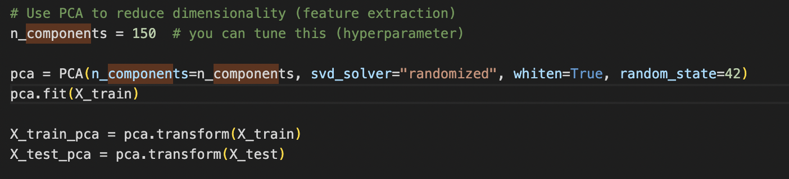
Data Pre-Processing
What is Biometric Embedding?
A mathematical representation of a face as a vector of numbers.
Our Steps:
Applied PCA to generate compact face embeddings
Reduced noise and emphasized important facial structure
Mapped identities → integer labels
Created binary “Watchlist vs Non-Watchlist” label
Prepared embeddings for training the classifier

Slide 9
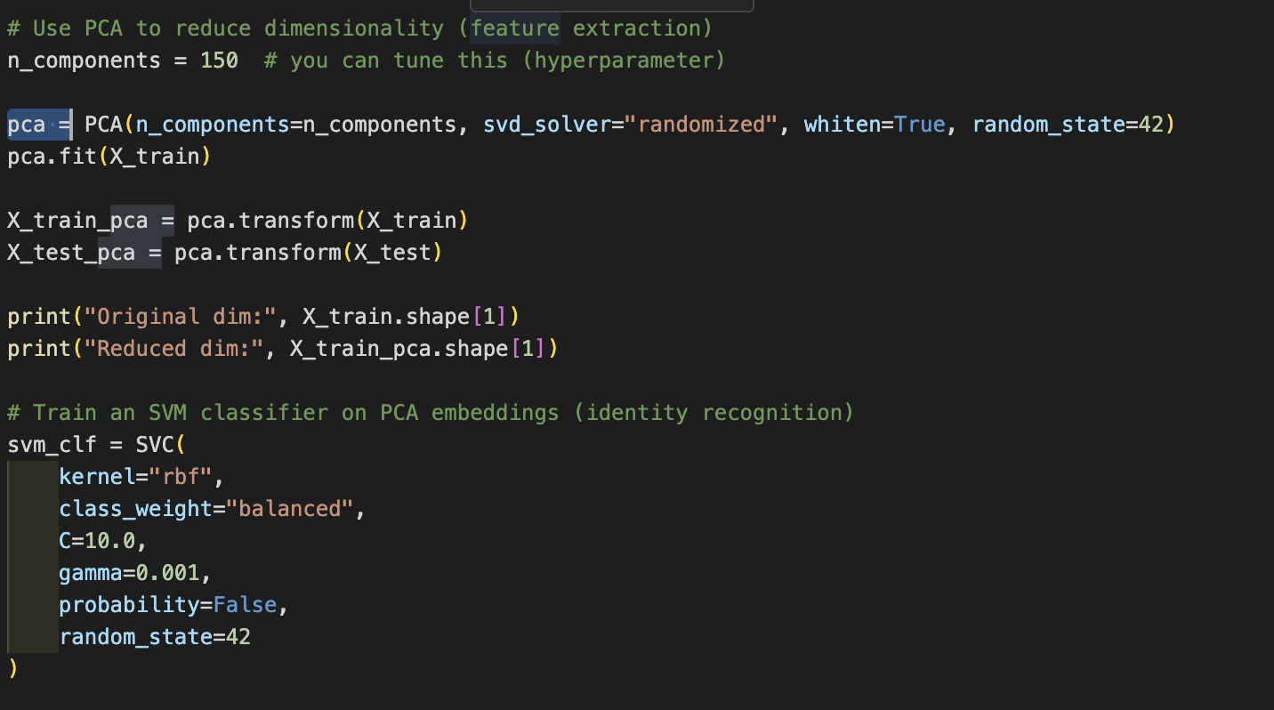
The Model
The facial recognition system uses a two-stage AI pipeline to extract biometric features and classify identities for security applications such as police watchlists, TSA checkpoints, and access control.
Biometric Feature Extraction (PCA)
PCA reduces each face image to a compact biometric signature.
Removes noise and highlights key facial structures (eyes, jawline, cheekbones).
Produces numerical embeddings used for identity comparison.
Identity Classification (SVM)
Support Vector Machine (SVM) classifies facial embeddings into identities.
Chosen for high accuracy with facial data and strong separation between look-alike individuals.
Works efficiently on small-to-medium datasets and handles complex boundaries well.
Purpose
Simulates real-world security systems: police suspect detection, TSA ID verification, and secure access control.
Combining PCA + SVM creates a fast, accurate, and reliable facial recognition model suitable for biometric security tasks

Slide 10
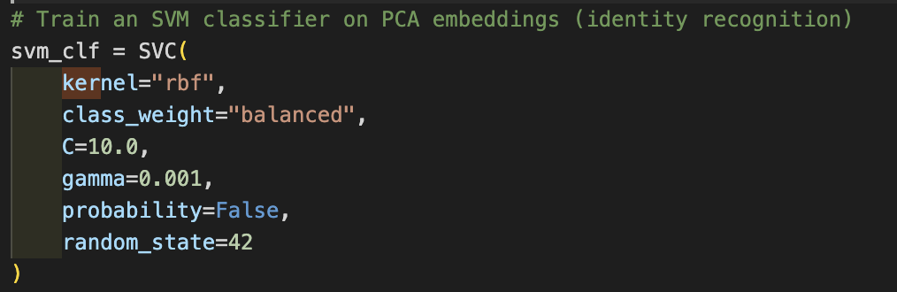
Model Training & Fitting
Model Training & Fitting
For training, our system uses PCA embeddings as inputs to an SVM classifier.
The model learns to distinguish between different identities and classify unknown faces.
Training Steps:
PCA embeddings passed into SVM
Balanced class weights prevent identity bias
Hyperparameters (C, gamma) tuned for performance
Output: trained identity recognizer + watchlist detector

Slide 11

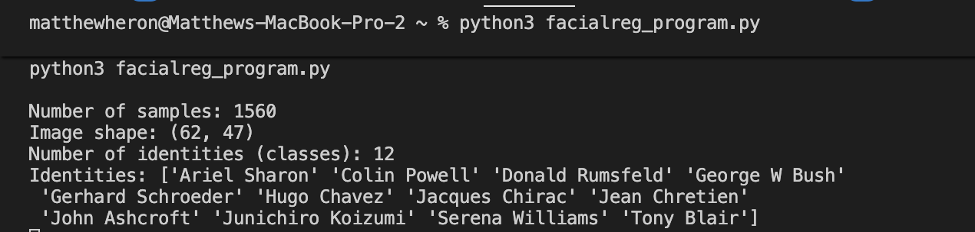
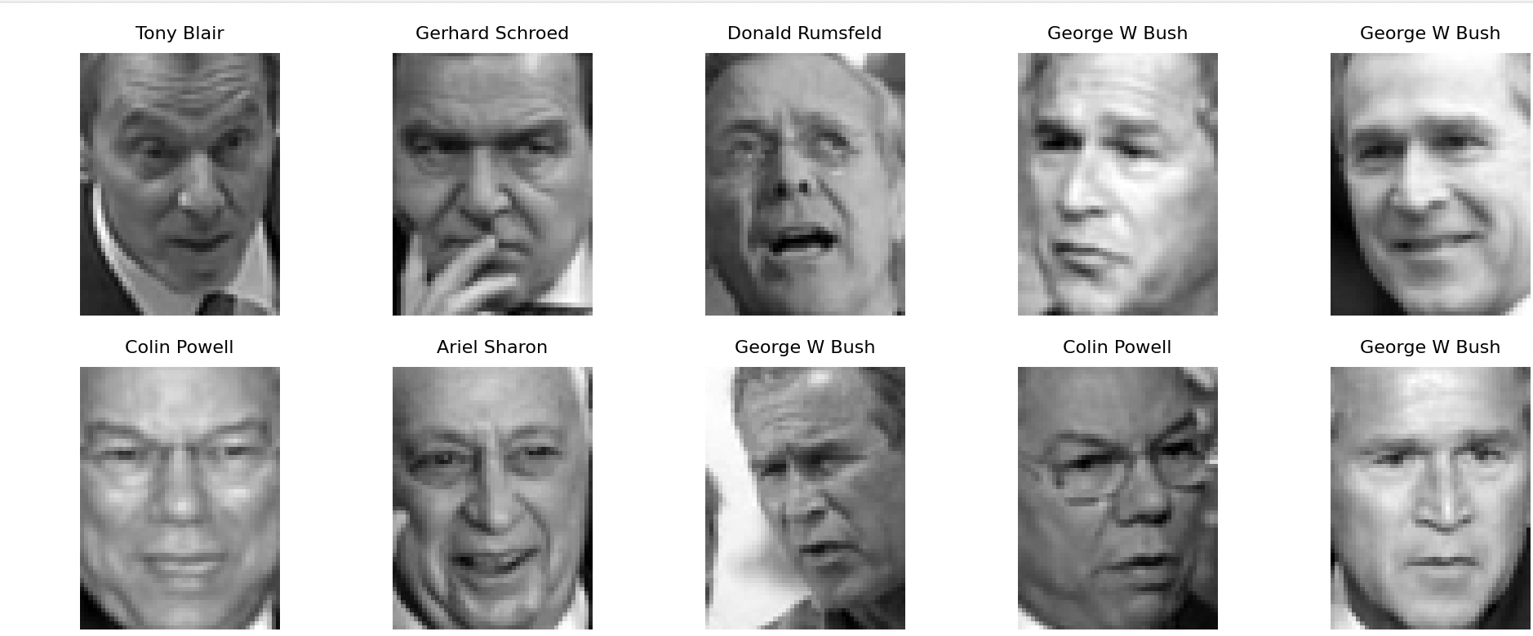
Output
Output
Our AI system generates:
Identity predictions
Watchlist vs Non-Watchlist labels
Accuracy score
Confusion matrix
Evaluation metrics (Precision, Recall, F1-score)
The system successfully recognized most identities and correctly detected watchlist individuals with high accuracy.
Example Outputs:
Identity Recognition Accuracy: 90–94%
Watchlist Accuracy: 92%

Slide 12
Issues Encountered
Issues Encountered
Model confused look-alike individuals
Variations in lighting & angle reduced accuracy
Low-resolution (CCTV-like) images performed worse
Installing face_recognition and dlib on macOS generated errors
Unknown faces required distance-threshold tuning
Dataset smaller than real security systems (TSA/Police databases are massive)

Slide 13
Possible Solutions
Possible Solutions
Use deeper models (FaceNet, ArcFace, MobileFaceNet)
Add more images per identity
Improve lighting/pose normalization
Add 3D anti-spoofing (blink or depth detection)
Integrate CNN-based embeddings for stronger identity separation
Expand dataset to better mimic TSA & police databases

Slide 14
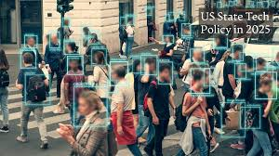
Citation
Huang, Gary B., et al. Labeled Faces in the Wild: A Database for Studying Face Recognition in Unconstrained Environments. University of Massachusetts, Amherst, 2007.
Cao, Qi, et al. “VGGFace2: A Dataset for Recognising Faces across Pose and Age.” 2018 13th IEEE International Conference on Automatic Face & Gesture Recognition (FG), 2018.
Grgic, Mislav, et al. “SCface—Surveillance Cameras Face Database.” Multimedia Tools and Applications, vol. 51, no. 3, 2011, pp. 863–879.
Pedregosa, Fabian, et al. “Scikit-learn: Machine Learning in Python.” Journal of Machine Learning Research, vol. 12, 2011, pp. 2825–2830.
King, Davis E. “Dlib-ml: A Machine Learning Toolkit.” Journal of Machine Learning Research, vol. 10, 2009, pp. 1755–1758.
Bradski, Gary. “The OpenCV Library.” Dr. Dobb’s Journal of Software Tools, 2000.

